Slide 1

LoRaWAN / NB-IoT: Low-Power, Long-Range IoT Communication Technologies
Course Title : Wireless and Mobile Communication
Presented by
Abdur Rahman Bijoy
IT-21056
Supervised by
Dr. Nazrul Islam
Associate Professor, Dept. of ICT, MBSTU

Slide 2
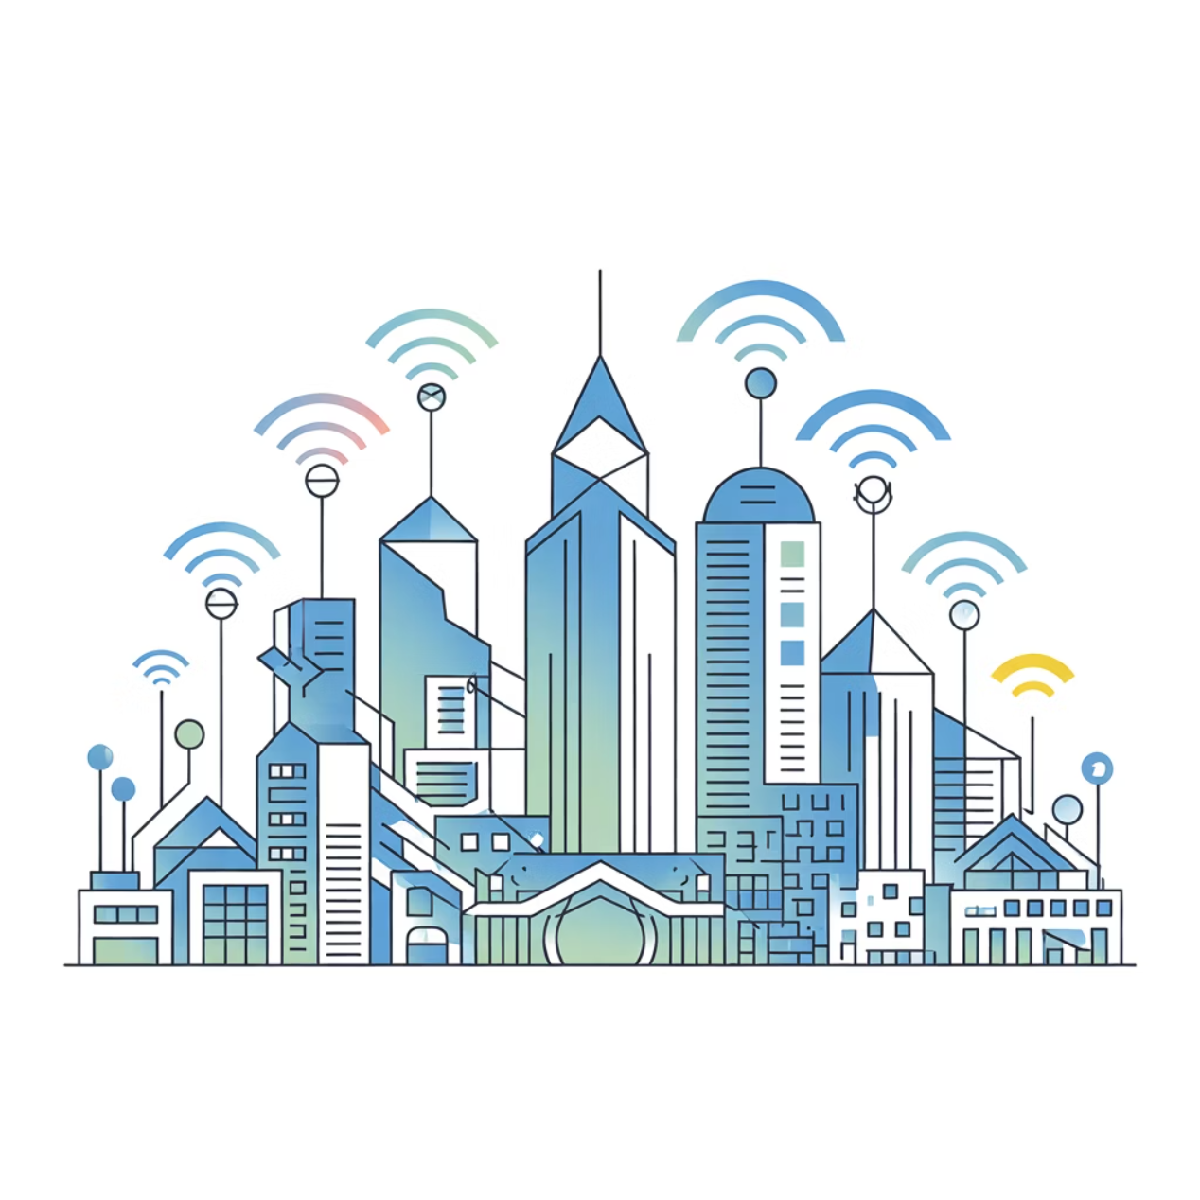
The Foundation: Why LPWAN is Essential for the IoT
The Internet of Things (IoT) connects billions of devices, generating valuable data for automation and efficiency. However, for massive-scale deployment, traditional networks (Wi-Fi, 4G/5G) are often too power-hungry or prohibitively expensive for widespread, battery-operated sensors.
This drives the need for specialized Low Power Wide Area Networks (LPWANs), such as LoRaWAN and NB-IoT, which are optimized for:
Low Power Consumption (ensuring multi-year battery life)
Wide-Area Connectivity (reaching remote or distant assets)

Slide 3
Defining the LPWAN Standard
Low Power Wide Area Networks (LPWAN) are wireless protocols designed for M2M and IoT applications, prioritizing battery life and range over high data throughput.
Long-Range Capability
Minimal Power Use
Low Data Rate
Connectivity extended up to 10–15 km in rural areas or 2–5 km in dense urban environments, overcoming distance limitations.
Devices are optimized to sleep for extended periods, enabling 5 to 10 years of operation on small batteries.
Focuses on transmitting small, periodic packets of data rather than continuous streaming, suitable for status updates and sensor readings.
LPWAN technologies are ideal for IoT use cases like smart meters, precision agriculture, and asset tracking.

Slide 4
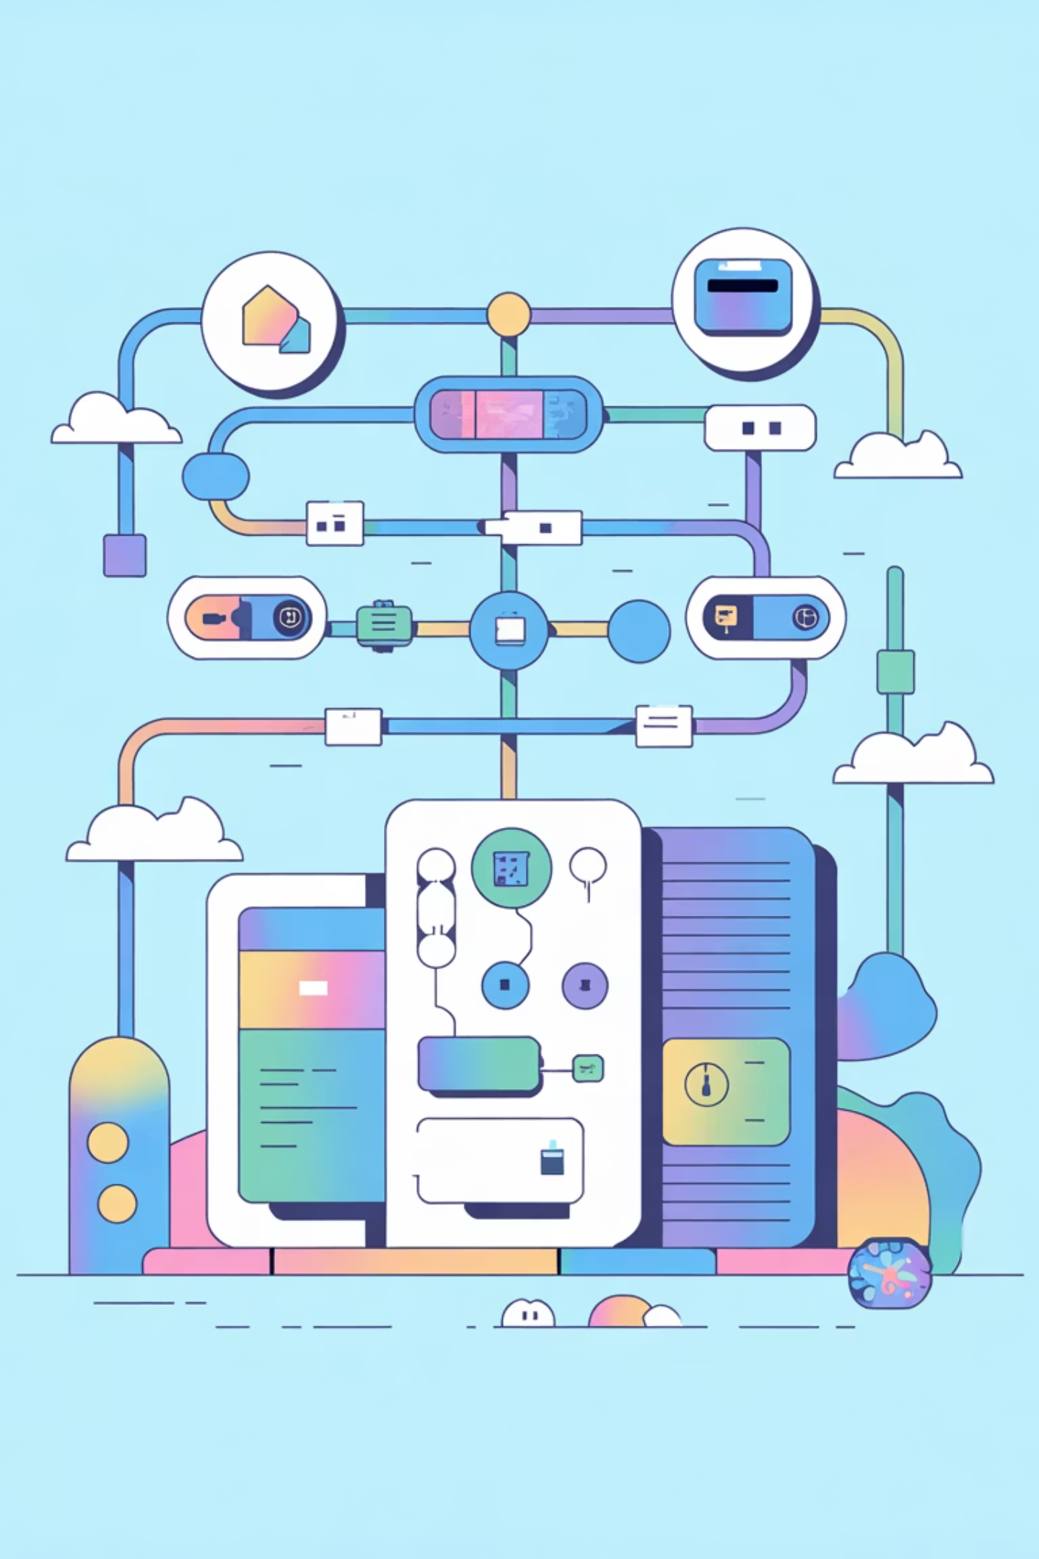
LoRaWAN: The Open Standard for IoT
1
2
LoRa Modulation
Unlicensed Spectrum
LoRaWAN utilizes the proprietary LoRa (Long Range) radio frequency technology, based on Chirp Spread Spectrum (CSS) to achieve high sensitivity and range.
Operates in the unlicensed ISM bands (Industrial, Scientific, and Medical), allowing anyone to set up a network without regulatory fees (e.g., 868 MHz in Europe, 915 MHz in North America).
3
Star-of-Stars Topology
Devices communicate wirelessly with gateways, which then use standard IP networks to forward data to a central Network Server.
LoRaWAN is characterized by a star-of-stars topology, designed primarily for asynchronous, uplink-focused communication where end-devices sporadically send data to the cloud.

Slide 5
NB-IoT: The Cellular Approach
Cellular & Licensed Spectrum
Deep & Reliable Coverage
NB-IoT is a standardized cellular LPWAN technology that operates in licensed spectrum, leveraging existing 4G/LTE infrastructure.
It provides exceptional deep indoor and underground coverage, ensuring reliable service for critical IoT applications.

Slide 6
Key Technical Features Comparison
Selecting the right technology requires a detailed look at the core specifications, particularly around spectrum, range, data throughput, and latency.
Spectrum
Unlicensed (ISM)
Licensed (Cellular)
Typical Range
5–15 km (Rural)
1–10 km (Urban/Rural)
Data Rate
0.3–50 kbps (Variable)
20–250 kbps (Higher Peak)
Device Cost
Low (Simple chip design)
Medium (Requires SIM/eSIM)
Network Operation
Private or Public (User setup)
Operator-managed (MNOs)
Latency
Higher (Asynchronous)
Lower (Synchronized)

Slide 7

Advantages and Limitations
LoRaWAN Strengths & Weaknesses
NB-IoT Strengths & Weaknesses
Open Ecosystem
Reliability & Security
No dependency on a single mobile operator; easy setup of private networks.
Carrier-grade QoS and security protocols inherent to licensed cellular networks.
Deployment Flexibility
Exceptional Coverage
Superior link budget allows for robust signal penetration indoors and underground.
Interference Risk
Operator Dependency
Unlicensed bands are susceptible to noise and regulatory duty-cycle limits.
Limited Downlink
Higher Connectivity Cost
Less capable for applications requiring frequent device updates or commands.

Slide 8
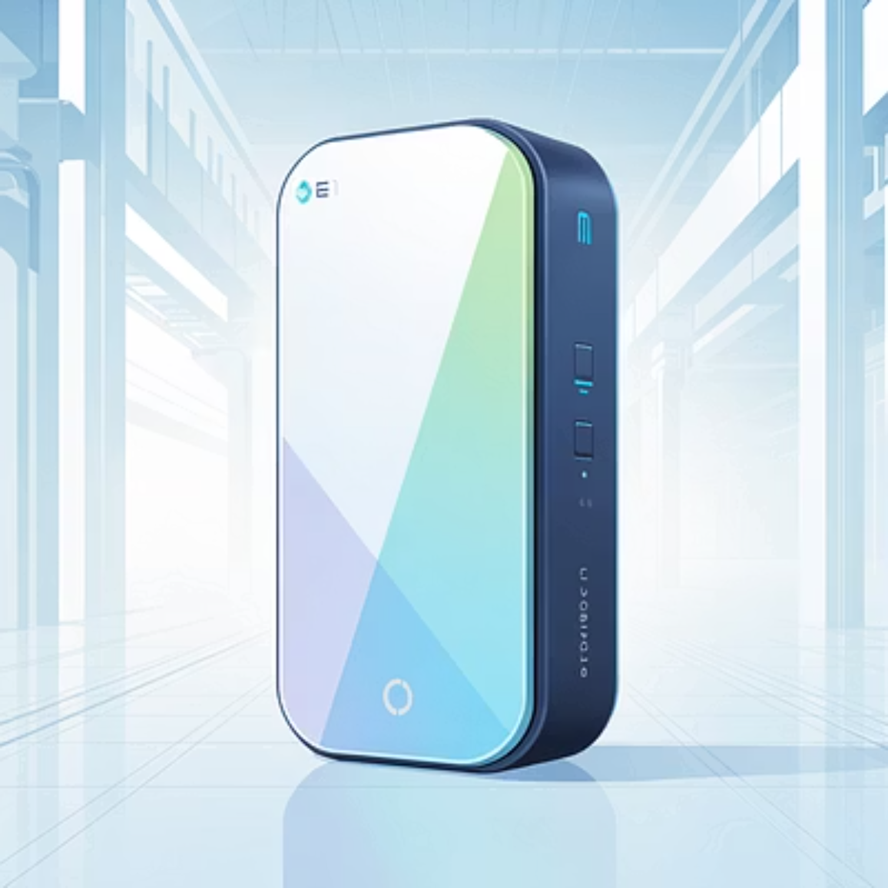
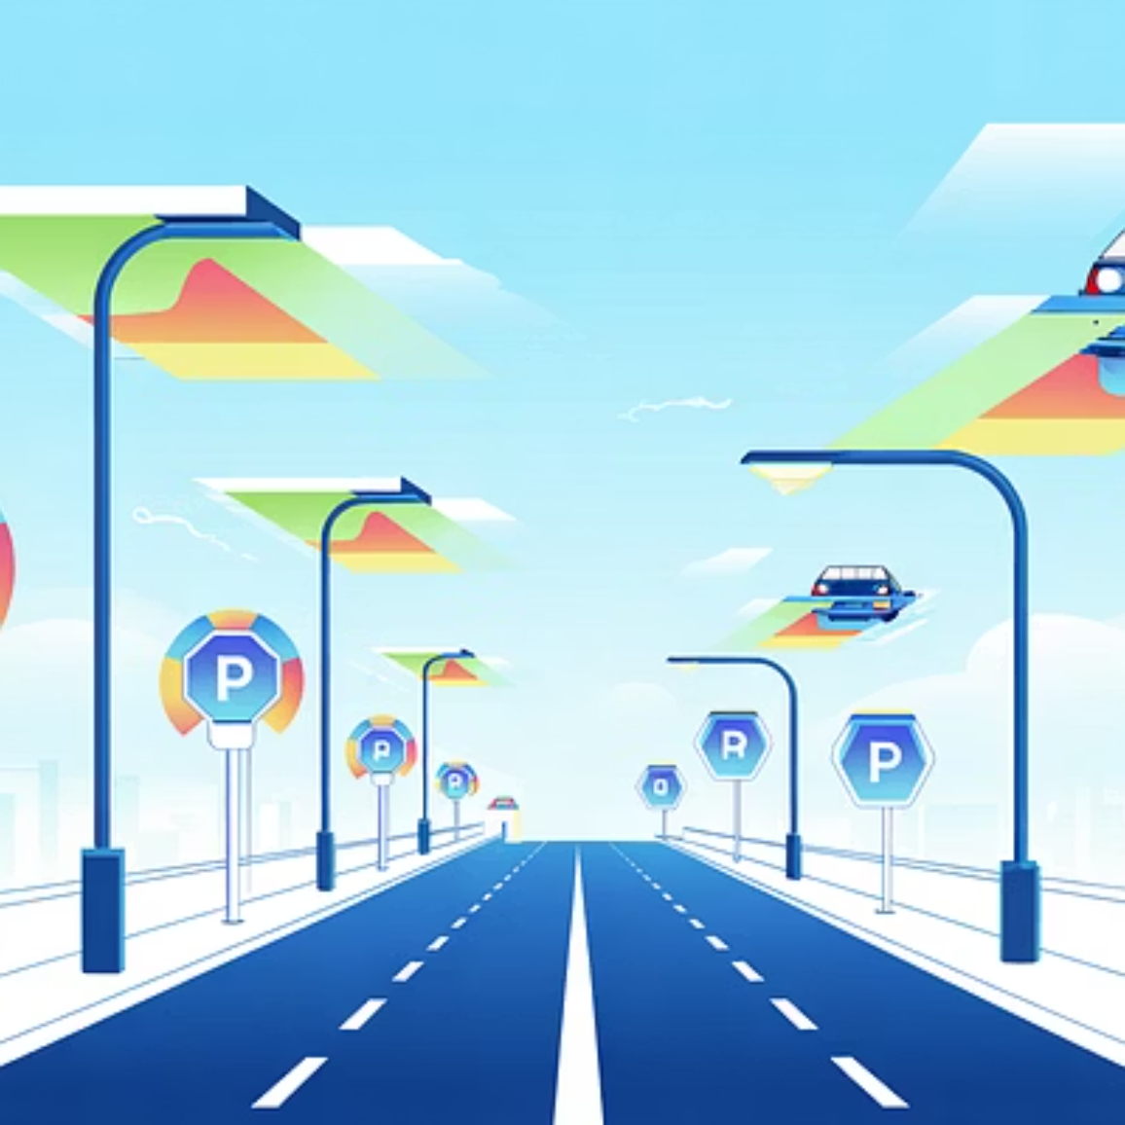

Real-World Applications: Where They Excel
LoRaWAN: Smart Cities
LoRaWAN: Smart Agriculture
Non-critical applications like tracking vacant parking spots, managing waste bins, and monitoring non-essential infrastructure assets.
Monitoring soil moisture, ambient temperature, and weather across vast, remote fields where cellular coverage may be sparse.
NB-IoT: Industrial Logistics
NB-IoT: Smart Metering
Real-time tracking of high-value goods, containers, and machinery, leveraging the reliable QoS of licensed networks.
Automated meter reading for utilities (water, gas, electricity) often located in basements or cabinets requiring deep penetration.

Slide 9


The Future Landscape of LPWAN
5G Integration
Hybrid Deployments
Cellular LPWAN (NB-IoT and its successor LTE-M) will be integrated into the 5G core network for enhanced latency and massive capacity.
Rise of networks combining the localized flexibility of LoRaWAN with the global reliability of NB-IoT to optimize coverage and cost.

Slide 10
Conclusion: Strategic Selection for IoT Success
Both LoRaWAN and NB-IoT are critical enablers for the future of the Internet of Things, each offering unique strengths for different deployment scenarios.
Together, they make IoT more efficient, connected, and sustainable.

Slide 11
THANK YOU

